Slide 1
Informatics - 312
Enterprise Risk Management

Slide 2
If you are new to the class today…
Please check in with Michaela Tran to be sure you are assigned to a small group.
Please carefully review my slides from last Wednesday, in which I went over the structure of the class as well as each of the assignments. And review Monday’s slides as well.
Please read the syllabus and the schedule carefully.
This is an in-person class, and you are expected to be here unless you are ill.
Both Michaela and I have office hours by appointment, so please contact one of us if you have any questions at all. Welcome!

Slide 3
Today’s Agenda
Housekeeping
NIST, CSRM and ERM
CSRM Frameworks
Integrating CSRM into ERM

Slide 4
You Oughta Know
What are the two different high-level approaches to risk analysis?
What are the key factors of any risk analysis?
What are some different techniques for performing a risk analysis?
Can you name some of the industry standard organizations and ERM frameworks?

Slide 5
NIST, CSRM and ERM

Slide 6
NIST
National Institute of Standards and Technology
an agency of the United States Department of Commerce whose mission is to promote American innovation and industrial competitiveness. NIST's activities are organized into physical science laboratory programs that include nanoscale science and technology, engineering, information technology, neutron research, material measurement, and physical measurement.
Mission
Promote U.S. innovation and industrial competitiveness by advancing measurement science, standards, and technology in ways that enhance economic security and improve our quality of life.
Notes:
“National Institute of Standards and Technology.” In Wikipedia, March 11, 2024. https://en.wikipedia.org/w/index.php?title=National_Institute_of_Standards_and_Technology&oldid=1213194707.

Slide 7
NIST
NIST has provided numerous well-accepted publications specific to risk management and cybersecurity specifically the NISTIR 8286 and CSFW
"This document is intended to help improve communications (including risk information sharing) between and among cybersecurity professionals, high-level executives, and corporate officers at multiple levels. The goal is to assist personnel in these enterprises and their subordinate organizations as well as systems owners to better identify, assess, and manage cybersecurity risks in the context of their broader mission and business objectives. This document will help cybersecurity professionals understand what executives and corporate officers need to carry out enterprise risk management (ERM).” [1] - NISTIR 8286
Notes:
Stine, Kevin, Stephen Quinn, Greg Witte, and R. K. Gardner. “Integrating Cybersecurity and Enterprise Risk Management (ERM).” National Institute of Standards and Technology, October 13, 2020. https://doi.org/10.6028/NIST.IR.8286.

Slide 8
CSRM vs ERM
Cybersecurity Risk management (CSRM)
Cybersecurity risks are a fundamental type of risk for all organizations to manage
Enterprise Risk Management (ERM)
When we use the word enterprise in an organizational context, we mean all aspects of that organization, spanning the entire breadth and depth of that org chart. ERM exists at the top level of the organizational hierarchy and spans risk considerations such as mission, financial, reputation, and technical risks thereof.
Notes:
National Institute of Standards and Technology. “NIST Cybersecurity Framework 2.0: Enterprise Risk Management Quick-Start Guide.” Gaithersburg, MD: National Institute of Standards and Technology, February 26, 2024. https://doi.org/10.6028/NIST.SP.1303.ipd.

Slide 9
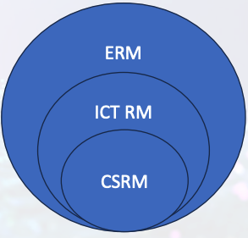
CSRM vs ERM
Information and Communications Technology (ICT) Risk Management
The ICT on which an enterprise relies is managed through a broad set of risk disciplines that include privacy, supply chain, and cybersecurity. ICT extends beyond traditional information technology (IT) considerations.
Notes:
National Institute of Standards and Technology. “NIST Cybersecurity Framework 2.0: Enterprise Risk Management Quick-Start Guide.” Gaithersburg, MD: National Institute of Standards and Technology, February 26, 2024. https://doi.org/10.6028/NIST.SP.1303.ipd.

Slide 10
CSRM Frameworks

Slide 11
NIST CSF 2.0
The CSF 2.0, which was released Feb 26, 2024, along with NIST’s supplementary resources, can be used by organizations to understand, assess, prioritize, and communicate cybersecurity risks; it is particularly useful for fostering internal and external communication across teams — as well as integrating with broader risk management strategies.
Notes:
National Institute of Standards and Technology. “NIST Cybersecurity Framework 2.0: Resource and Overview Guide.” Gaithersburg, MD: National Institute of Standards and Technology, February 26, 2024. https://doi.org/10.6028/NIST.SP.1299.

Slide 12
NIST CSF 2.0
CSF Core - A taxonomy of high-level cybersecurity outcomes that can help any organization manage its cybersecurity risks.
CSF Organizational Profiles - A mechanism for describing an organization’s current and/or target cybersecurity posture in terms of the CSF Core’s outcomes.
CSF Tiers - Can be applied to CSF Organizational Profiles to characterize the rigor of an organization’s cybersecurity risk governance and management practices.
Notes:
National Institute of Standards and Technology. “NIST Cybersecurity Framework 2.0: Resource and Overview Guide.” Gaithersburg, MD: National Institute of Standards and Technology, February 26, 2024. https://doi.org/10.6028/NIST.SP.1299.

Slide 13
NIST CSF 2.0
The CSF 2.0 is organized by six Functions — Govern, Identify, Protect, Detect, Respond, and Recover.
Under these functions are Categories and Subcategories
Subcategories also have Informative References and Implementation Examples
Notes:
National Institute of Standards and Technology. “NIST Cybersecurity Framework 2.0: Resource and Overview Guide.” Gaithersburg, MD: National Institute of Standards and Technology, February 26, 2024. https://doi.org/10.6028/NIST.SP.1299.

Slide 14
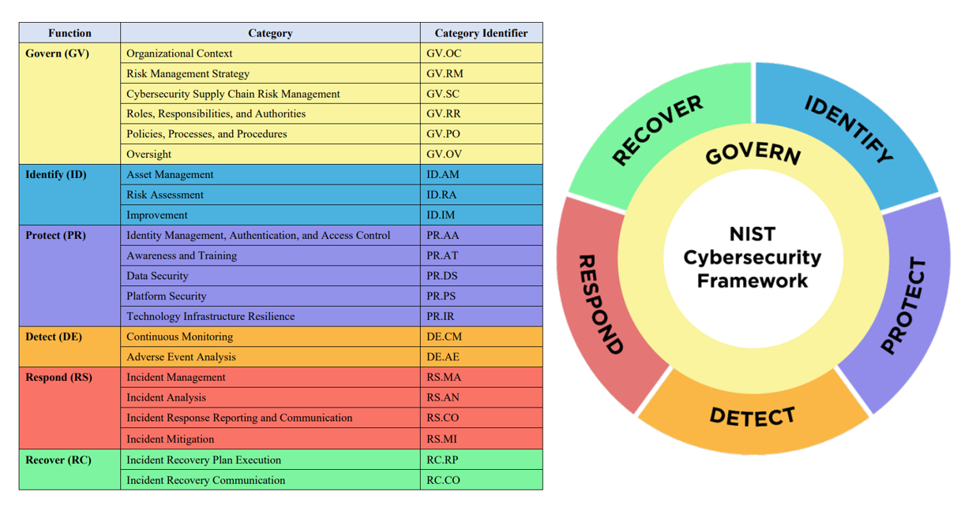
NIST CSFW 2.0
The CSF 2.0 is organized by six Functions — Govern, Identify, Protect, Detect, Respond, and Recover.
Notes:
National Institute of Standards and Technology. “NIST Cybersecurity Framework 2.0: Resource and Overview Guide.” Gaithersburg, MD: National Institute of Standards and Technology, February 26, 2024. https://doi.org/10.6028/NIST.SP.1299.

Slide 15
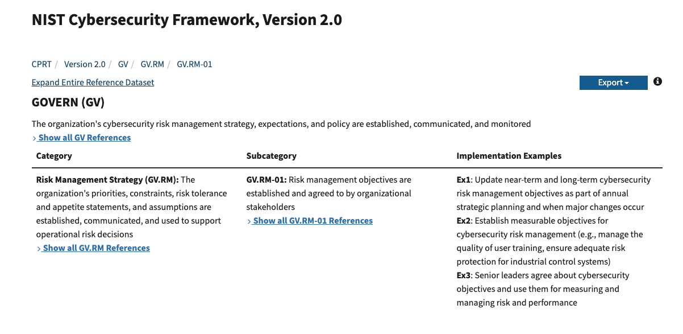
NIST CSFW 2.0

Slide 16
Privacy: 1890 to Today
“Privacy may be understood as a right to control access to and use of both physical items, like bodies and houses, and to information, like medical and financial facts. Physical privacy affords individuals access control rights over specific bodies, objects, and places.” – Professor Adam Moore, 2008
“The Right to Privacy" is a law review article written by Samuel Warren and Louis Brandeis and published in the 1890 Harvard Law Review. The case involves a photograph of a wedding party and the question is whether the person needs to be identified. It is the first publication in the United States to advocate a right to privacy, articulating that right primarily as a "right to be let alone.”

Slide 17
U.S. Privacy Law vs EU Privacy
EU laws came on the books after World War II, when the Nazis used IBM computers to record data on its victims
Europeans focused on preventing discrimination and built individual ownership of data as a primary principle (Opt-In)
In the U.S. algorithms generate data sets for purposes such as credit scores, profiling and inferences
In the U.S. consent is generally assumed but it is a fragile concept -- when someone says “no,” you must stop (Opt-Out)
We are considering the concept of “openness” when aggregate data sets are available
Concept of “public good” v. privacy where data is concerned.
Who owns the data? We can v. we should. Unethical v Legal.

Slide 18
Security and Privacy
Just as a person has morally protected privacy interests that permit her to exclude persons from the information in her home, a person has morally protected privacy interests that protect the data on her computer.
“Reasonable Security” or “information/data protection” has been defined and redefined over the years .
While privacy definitions crystalized in the 1960s, it was not until 1999 with the GLBA that we get action around both the protection of personal information and the penalties that accrue to those whose lax security measures permit hacking.
Today, we’re going to take a quick look – an overview – of some of the areas we’ll cover in greater detail in the first weeks of this course.

Slide 19
Our personal information has value
Our definition of “personal information” has morphed in the past and is still changing.
Large data breaches or platform vulnerabilities are currently unaddressed by uniform, consistent guidance from Congress (by law) or from U.S. regulators.
We have a patchwork of definitions of what constitutes “reasonable policies and practices” or “reasonable security requirements” to protect personal information.
Only your personal health information is protected with one law.
15 states have enacted some form of information security provisions as part of state breach notice, but most do not state what reasonable protection of that information would be.

Slide 20
Is Privacy Still Available?
Three aspects of digital privacy
Freedom from intrusion – being left alone
Control of information about oneself
Freedom from surveillance (followed, tracked, watched, eavesdropped upon)
Categories of threats
Intentional collection of personal information (gov’t = IRS, law enforcement; private sector = mining for marketing and decisioning)
Unauthorized release or use by insiders
Theft of information
Inadvertent leakage
Our own actions (intentional, inadvertent)

Slide 21
Caveats
Your control of information about yourself is often limited by the First Amendment
“Don’t say anything you would be uncomfortable being quoted on in the newspaper”
Privacy controls can be breached
You are sometimes willing to give up privacy controls for the sake of convenience (third party apps) or ease of communication with many at the same time
Batya Friedman has identified the cloud as creating a whole new realm of information that can never be deleted or revised
What surveillance data is intended for originally often gets recast down the road

Slide 22
Informed Consent & Info Gathering
In theory, companies you deal with on the Internet provide you with their privacy policy along with their terms of service. You give or decline your “informed consent.”
How many “I agree” boxes have you checked?
What if you don’t read but just check the box?
“Secondary use” of information = mining the data for purposes of than for which it was provided
“Data mining” = linking bits of data together to create a profile for law enforcement or marketing purposes
“Opt in/opt out” = some control over secondary uses
Default now usually set to “opt out.”

Slide 23
What are controls?

Slide 24
What are controls?
“[Internal] Systematic measures (such as reviews, checks and balances, methods and procedures) instituted by an organization to (1) conduct its business in an orderly and efficient manner, (2) safeguard its assets and resources, (3) deter and detect errors, fraud, and theft, (4) ensure accuracy and completeness of its accounting data, (5) produce reliable and timely financial and management information, and (6) ensure adherence to its policies and plans.”
-- businessdictionary.com
[External] “An external control is an action taken by an outside party that impacts the governance of a business. For example, a government could enact a law that prohibits a firm from using discriminatory hiring practices.” – accountingtools.com
Often internal controls are represented as policies and procedures necessary to ensure that risk responses are carried out.

Slide 25
Types of control activities
Directive -- Setting corporate policies, department policy and procedures; Setting spending limits; Setting IT configuration standards
Preventive -- Training on applicable policies, department policy/procedures; Review and approval process for purchase requisitions to make sure they are appropriate before the purchase; IT access authorizations to ensure access is appropriate; use of passwords to stop unauthorized access to systems/applications
Detective -- Cash counts; bank reconciliation; Review your payroll reports; Compare transactions on reports to source documents; Monitor actual expenditures against budget; Review logs for evidence of mischief;
Corrective -- Submit corrective journal entries after discovering an error; Complete changes to IT access lists if individual’s role changes
- Recovery -- Prepare data backups from current systems; Storing documents and IT backups in a protected environment to ensure availability; Restore data from backup following a failure;
-Automated -- IT access permissions; System password requirements; Preset spending limits;

Slide 26
Ensuring control
Make sure you have up-to-date policies and procedures;
Ensure that authorization limits are communicated within your department;
Ensure all assets (especially cash) are safeguarded;
Establish document control (especially for spreadsheets);
Ensure approval signatures are visible (legible) on all required documentation;
Make sure data is only accessible by authorized personnel;
Understand your department/function’s risks; and
Ensure adherence to policy and legal/regulatory requirements.

Slide 27
When thinking about controls, ask:
Propriety of transactions
Is this legal, and right? Does it feel or look wrong? Would someone else think so?
Reliability and integrity of information
Is the information/form/data/report accurate and complete?
Compliance with policies and government regulations
Are you following established procedures/instructions?
Safeguarding assets
Could anyone gain access to items under your control without being observed?
Economy and efficiency of operations
Is there a better way to do the job?
Does it address a risk of significance to the organization?

Slide 28
When reporting where controls and control activities are concerned:
Is the content of reported information appropriate?
Is the information timely and available when required?
Is the information the most current/most available?
Is the data correct?
Is the information accessible to appropriate parties?

Slide 29
Federal Enforcement Agencies
“The Federal Trade Commission(FTC) has now brought more than 50 enforcement proceedings relating to data security.
The Consumer Financial Protection Bureau (CFPB) recently brought its first data security enforcement action, resulting in a $100,000 fine and setting specific expectations for the board of directors.
The Securities and Exchange Commission (SEC) requires companies to disclose material cybersecurity risks and incidents to investors and has levied penalties on firms for cybersecurity lapses.”
“Cyber risk is more than a technology issue; it carries enterprise-wide legal, operational, and financial implications that endanger virtually all organizations. For some well-known companies, those risks are no longer theoretical, and they struggle to repair the damage done to their operations, reputation, and profits – a process that often takes years.” – Coalfire White Paper, 2017

Slide 30
Group Activity – Exploring the CSF 2.0
Navigate to the NIST CPRT
https://csrc.nist.gov/projects/cprt/catalog#/cprt/framework/version/CSF_2_0_0/home
Explore the CSF and be prepared to discuss what the function is about, giving an example of what the type of controls would fit into each category
Govern Group 1
Identify Group 2
Protect Group 3
Dealers Choice - Lucky Group 7
Each member of the group should present on one example of a control and be able to discuss why the control fits in the function you were assigned.
Detect Group 4
Respond Group 5
Recover Group 6
Notes:
National Institute of Standards and Technology. “NIST Cybersecurity Framework 2.0: Resource and Overview Guide.” Gaithersburg, MD: National Institute of Standards and Technology, February 26, 2024. https://doi.org/10.6028/NIST.SP.1299.

